Slide 1
Academic Writing
Technical Report Writing
Lectures 4 & 5
20th & 22nd August 2019

Slide 2
Objective: To understand the nature of academic texts
Characteristics of an Academic Text
The Anatomy of an Academic Article
Genres of Academic Texts
Rhetorical Modes used in Academic Texts

Slide 3
1. Characteristics of an Academic Text >>
Formal
Objective
Precise

Slide 4
1. Characteristics of an Academic Text >>
Academic texts avoid casual or conversational language and to do this they make use of formal vocabulary.
Examples:
the use of ‘somewhat’ c.f. ‘a bit’;
avoiding contractions like didn’t and using ‘did not’ instead;
avoiding emotional tones such as ‘wonderful or ‘terrible’ and using moderate phrases such as ‘helpful’ or ‘problematic’;
avoiding the use of absolute positives and negative such as ‘wrong’ and opting instead for words like ‘less convincing’

Slide 5
1. Characteristics of an Academic Text >>
Use of Objective language:
Objective language focuses on the plain facts about a person or object.
In contrast, subjective language focuses on the attitudes, values, thoughts, feelings, or beliefs of the person who is doing the writing or speaking.

Slide 6
1. Characteristics of an Academic Text >>
Examples:
paracetamol is sold over the counter as a pain medication.
paracetamol is the most dangerous over-the-counter pain medication.
A 2013 episode of This American Life presented a number of studies that verified that paracetamol has killed more people than any other over-the-counter pain medication.
In the This American Life episode on paracetamol, one segment described the tragic death of a five-month-old baby and thus should convince listeners that the Federal Drug Administration (FDA) must take immediate action.

Slide 7
1. Characteristics of an Academic Text >>
Precise Language:
Academic writing makes committed efforts to be precise when presenting information.
Imprecise or ambiguous terms such as “a lot of people” are generally avoided in favour of stating exact figures such as “50 million people”.
The use of qualifications:
Example 1: Chinese are Buddhist. They go to the temple five times a year, live simple lives, and give money to charity.
Example 2: Many Chinese are Buddhists. Practising Buddhists go to the temple about five times a year, generally try to live simple lives, and give money to charity when they can.

Slide 8
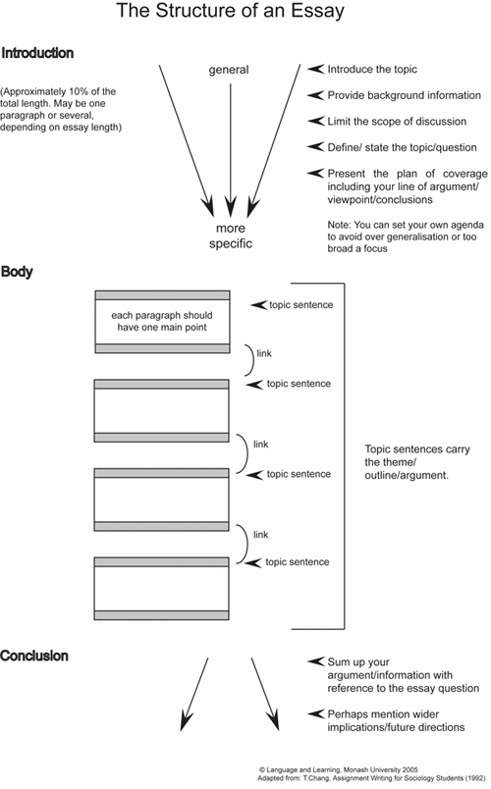
2. Anatomy of an Academic Text >>
The Classic Essay
Source: English Skills One (2018)

Slide 9
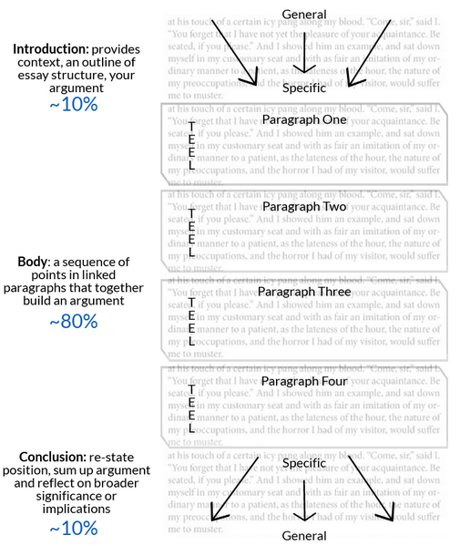
2. Anatomy of an Academic Text >>
The Classic Essay
Source: Monash University (n.d.)

Slide 10
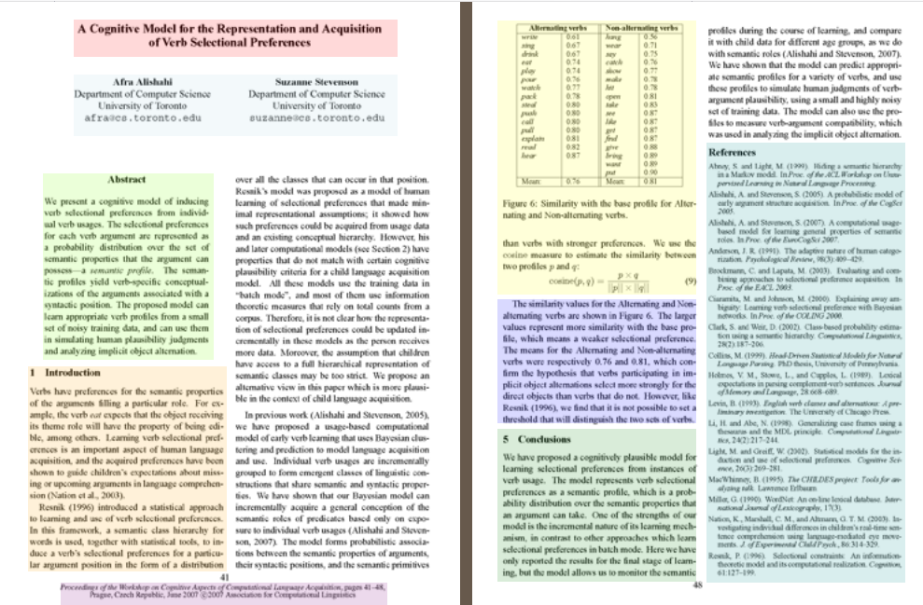
2. Anatomy of an Academic Text >>
The Academic Article
Source: NCSU Libraries (2009)

Slide 11
2. Anatomy of an Academic Text >>
Parts of an Academic Article
Title
Authors
Financial equipment Support
Abstract
Introduction
Literature review
Main body
Conclusion
Acknowledgements
References
Source: NCSU Libraries (2009)

Slide 12
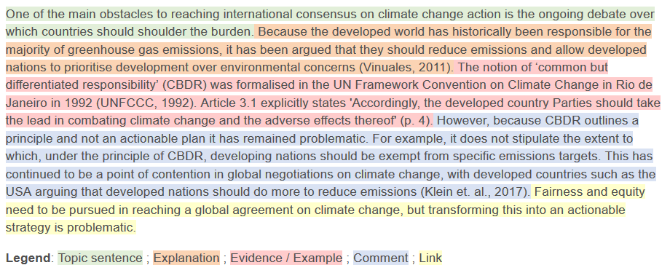
2. Anatomy of an Academic Text >>
Parts of an Academic Article
Title
Authors
Financial equipment Support
Abstract
Introduction
Literature review
Main body
Conclusion
References
Figure: Using TEEcL when Structuring a Paragraph
Notes:
Topic sentence – the first sentence in a body paragraph that tells the reader what the main idea or claim of the paragraph will be.
Explanation – Explain what you mean in greater detail.
Evidence – Provide evidence to support your idea or claim. To do this, refer to your research. This may include: case studies, statistics, documentary evidence, academic books or journal articles. Remember that all evidence will require appropriate citation.
Comment – Consider the strengths and limitations of the evidence and examples that you have presented. Explain how your evidence supports your claim (i.e. how does it ‘prove’ your topic sentence?).
Link – Summarise the main idea of the paragraph, and make clear how this paragraph supports your overall thesis.

Slide 13
3. Genres of Academic Texts >>
Essays
Research paper/article
Proposal
Review of literature
Dissertation/Thesis

Slide 14
4. Rhetorical Modes used in Academic Texts >>
Descriptive
Analytical
Critical
Persuasive

Slide 22
Most of the forest fires that are killing global biodiversity today are caused by humans in one or other way

Slide 23
Academic writing
There are four types of academic writing: descriptive, analytical, persuasive and critical
Descriptive writing
It is the simplest type of academic writing
The purpose of this type of writing is to provide facts or information. For, example, a summary of an article or a report of the results of an experiment
Analytical Writing
Most academic writing is analytical
Analytical writing includes descriptive writing, but also requires re-organise the facts and information
The kinds of instructions for an analytical assignment include: 'analyse', 'compare', 'contrast', 'relate', and 'examine'.

Slide 24
Academic Writing
Persuasive writing
Every academic writing goes through persuasive writing which caries all the features of analytical writing, with the addition of researcher’s own point of view (Opinion articles, Editorials)
Most essays are persuasive, and there is a persuasive element in at least the discussion and conclusion of a research article
Points of view in academic writing can include an argument, recommendation, interpretation of findings or evaluation of the work of others
In persuasive writing, each claim needs to be supported by some evidence. For example a reference to research findings or published sources.
The kinds of instructions for a persuasive assignment include: 'argue', 'evaluate', 'discuss', and 'take a position'.

Slide 25
Academic Writing
Critical writing
It has all the features of persuasive writing, with the added feature of at least one other point of view
While persuasive writing requires researcher’s point of view on an issue or topic, critical writing requires the researcher to consider at least two points of view, including his/her own
For example, critical writing assignments include a critique of a journal article, or a literature review that identifies the strengths and weaknesses of existing research.
The kinds of instructions for critical writing include: 'critique', 'debate', 'disagree' and 'evaluate'. You need to: accurately summarise all or part of the work
Critical writing requires strong writing skills. You need to thoroughly understand the topic and the issues

Slide 26
Identify the central theme
Write Summary or abstract → Descriptive Writing
Write review of literature → Analytical Writing
Writing discussion and conclusion → Persuasive Writing
Critical Writing

Slide 27
References >>
ASK Academic Skills (n.d.) 'The Power of the Paragraph', Available online: https://vimeo.com/44666462 [Accessed on 5th June 2019]
Best Custom Writing (2018) 'The 4 Types of Academic Writing' Available online:https://www.bestcustomwriting.com/blog/types-of-academic-writing [Accessed on 5th June 2019]
Branson, R. D. (2004) ‘The Anatomy of an Academic Article’ in Respiratory Care, Vol. 49 (October), No. 10. Available online: http://www.rcjournal.com/contents/10.04/10.04.1222.pdf [Accessed on 5th June 2019]
English Skills One (2018) 'Unit II - Genres and Types of Academic Writing' Available online: https://www.englishskillsone.com/units-1-iv/c/0/i/21114864/unit-ii-genres-and-types-academic-writing [Accessed on 5th June 2019]
Hartley, J. (2008) Academic Writing and Publishing: A practical handbook. New York: Routledge.
Lund University (2011) 'Academic Writing in English', Available online: https://awelu.srv.lu.se/sources-and-referencing/writing-acknowledgements/ [Accessed on 5th June 2019]
Medawar, P (1964) ‘Is the Scientific Paper a Fraud?’ Listener. 1963;70:377–378. Available Online: http://www.weizmann.ac.il/mcb/UriAlon/sites/mcb.UriAlon/files/uploads/medawar.pdf [Accessed on 5th June 2019]
Monash University (n.d.) 'Research and writing for assignments'. Available online: https://www.monash.edu/rlo/research-writing-assignments/writing/clear-communication/writing-clearly-concisely-and-precisely [Accessed on 6th June 2019]
NCSU Libraries (2009) 'Anatomy of a Scholarly Article' Available online: https://www.lib.ncsu.edu/tutorials/scholarly-articles/ [Accessed on 5th June 2019]
UEFAP (n.d.) 'Features of Academic Writing'. Available online: http://www.uefap.com/writing/feature/precise.htm [Accessed on 6th June 2019]
University of Sydney (2019) 'Writing' Available online: https://sydney.edu.au/students/writing.html [Accessed on 5th June 2019]

